Slide 1
Image Processing
Kiran TALELE
talelesir@gmail.com
99870 30 881

Slide 2
Kiran TALELE
4
Image Compression
Image Processing
4
Morphology
3
Image Segmentation
2
Image Enhancement
1
Image Fundamentals

Slide 3
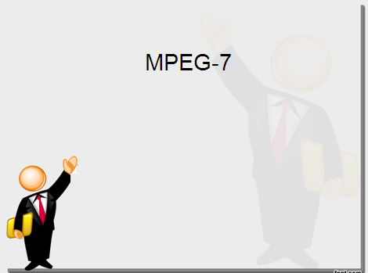

Image Fundamentals

Slide 4

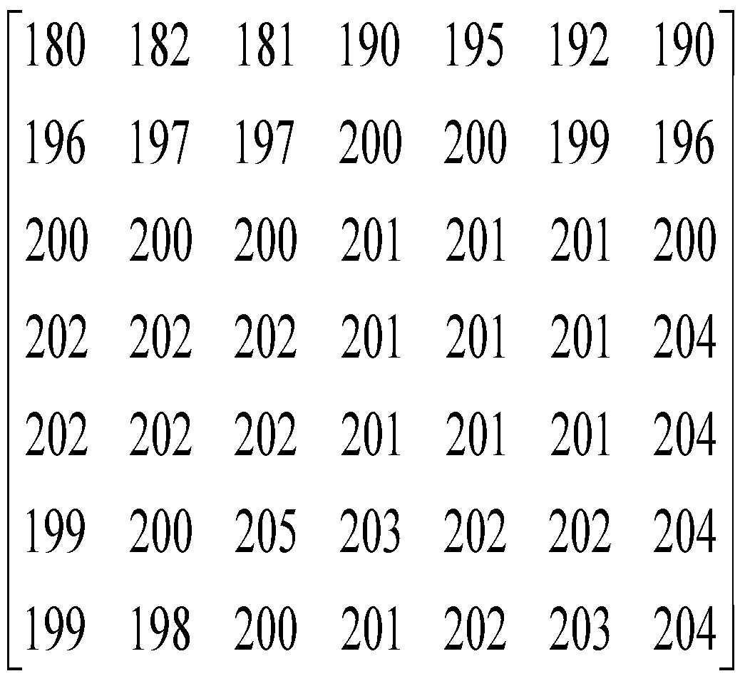
[1] Digital Image
Digital Image is obtained by sampling continuous image at a regular intervals of distance
Input
Output
Sampling
Quantization
F(x,y)
F(x,y)
180.4 | 181.9 | . . . . | 189.6
195.8 | 197.2 | . . . . | 196.1
. . . |  | . . . . | . . .
199 | 198.3 |  | 204
Kiran TALELE 99870 30 881 talelesir@gmail.com

Slide 5
[2] Spatial Resolution Vs Tonal Resolution
SPATIAL RESOLUTION | TONAL RESOLUTION
(1) It is referred to as | (1) It is referred to as
(2) | (2)
(3) | (3)
(4) | (4)
Kiran TALELE 99870 30 881 talelesir@gmail.com

Slide 6
[2] Spatial Resolution Vs Tonal Resolution
SPATIAL RESOLUTION | TONAL RESOLUTION
(1) It is referred to as Sampling | (1) It is referred to as Quantization
(2) | (2)
(3) | (3)
(4) | (4)
Kiran TALELE 99870 30 881 talelesir@gmail.com

Slide 7
[2] Spatial Resolution Vs Tonal Resolution
SPATIAL RESOLUTION | TONAL RESOLUTION
(1) It is referred to as Sampling | (1) It is referred to as Quantization
(2) It is determined by no. of samples in the image | (2) It is determined by no of gray levels in the image
(3) | (3)
(4) | (4)
Kiran TALELE 99870 30 881 talelesir@gmail.com

Slide 8


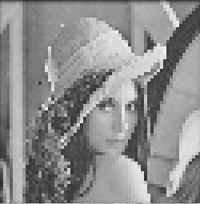
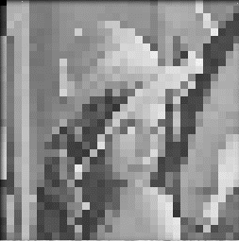
Image Sampling (Example)
Change of
Spatial Resolution
original image sampled by a factor of 2
sampled by a factor of 4 sampled by a factor of 8

Slide 9




Image quantization (example)
256 gray levels (8bits/pixel) 32 gray levels (5 bits/pixel) 16 gray levels (4 bits/pixel)
8 gray levels (3 bits/pixel) 4 gray levels (2 bits/pixel) 2 gray levels (1 bit/pixel)

Slide 10




Change of
Tonal Resolution
Grey-scale quantization

Slide 11
[2] Spatial Resolution Vs Tonal Resolution
SPATIAL RESOLUTION | TONAL RESOLUTION
(1) It is referred to as Sampling | (1) It is referred to as Quantization
(2) It is determined by no. of samples in the image | (2) It is determined by no of gray levels in the image.
Increase in spatial resolution increases minute details | (3)
(4) | (4)
Kiran TALELE 99870 30 881 talelesir@gmail.com

Slide 12
[2] Spatial Resolution Vs Tonal Resolution
SPATIAL RESOLUTION | TONAL RESOLUTION
(1) It is referred to as Sampling | (1) It is referred to as Quantization
(2) It is determined by no. of samples in the image | (2) It is determined by no of gray levels in the image.
Increase in spatial resolution increases minute details | (3) Increase in tonal resolution improves quality & contrast of picture.
(4) Decrease in spatial resolution gives Checker Board (i.e. Blocking) effect. | (4)
Kiran TALELE 99870 30 881 talelesir@gmail.com

Slide 13
[2] Tonal Resolution Vs Spatial Resolution
SPATIAL RESOLUTION | TONAL RESOLUTION
(1) It is referred to as Sampling | (1) It is referred to as Quantization
(2) It is determined by no. of samples in the image | (2) It is determined by no of gray levels in the image.
Increase in spatial resolution increases minute details | (3) Increase in tonal resolution improves quality & contrast of picture.
(4) Decrease in spatial resolution gives Checker Board (i.e. Blocking) effect. | (4) Decrease in tonal resolution gives false contour in image.
Kiran TALELE 99870 30 881 talelesir@gmail.com

Slide 14

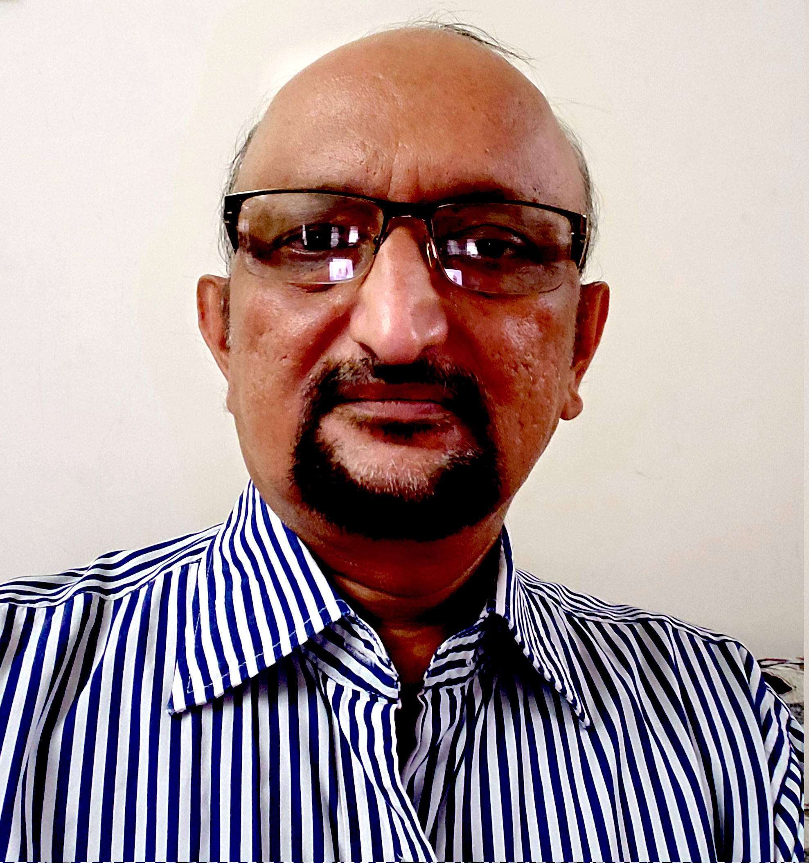


Dr. Kiran TALELE
Academic : PhD
Professional :
Dean-Students, Alumni & External Relations @ Bharatiya Vidya Bhavans’ Sardar Patel Institute of Technology (SP-IT), Mumbai
Head-Academic Relation @ Sardar Patel Technology Business Incubator (SP-TBI), Mumbai
Treasurer-IEEE Bombay Section
091-9987030881
kiran.talele@spit.ac.in / ktvtalele@gmail.com
https://www.linkedin.com/in/k-t-v-talele/
www.facebook.com/Kiran-Talele-1711929555720263
Stay Connected
14
14

Slide 15
Dr. Kiran TALELE is an Associate Professor in Electronics & Telecommunication Engineering Department of Bharatiya Vidya Bhavans’ Sardar Patel Institute of Technology, Mumbai with 33+ years experience in Academics.
He is a Dean of Students, Alumni and External Relations at Sardar Patel Institute of Technology, Andheri Mumbai.
He is also a Head of Sardar Patel Technology Business Incubator, Mumbai.
His area of research is Digital Signal & Image Processing, Computer Vision, Machine Learning and Multimedia System Design.
He has published 85+ research papers at various national & international refereed conferences and journals. He has filed published 25+ patents at Indian Patent Office. One patent is granted in 2021.
He is a Treasurer of IEEE Bombay Section and Mentor for Startup Incubation & Intellectual Asset Creation.
He is a recipient of P.R. Bapat IEEE Bombay Section Outstanding Volunteer Award 2019.

